Slide 1

London Funders Housing and Homelessness Network
Web: stonewallhousing.org Facebook/Instagram: Stonewall Housing Twitter: @stonewallhousin
Notes:
AIM:
Raise awareness about issues pertinent to both LGBT and Well being ( i.e. recognise the careful use of words on affected individuals, such as using the word ‘Depression’ adversely etc)
FORMAT:
40 minutes. Credit Suisse has over 4000 employees based in London and the event would attract 100 people or more
WELCOME:
Bob: CEO, Jenny: Mental Health Advocate, Melissa: Psychology Student
HOUSEKEEPING:
Fire alarm, toilets, mobile phones
PRIEST:
If not strike oil in 5 minutes then stop drilling, short sermons, could you not make it 4 minutes?

Slide 2
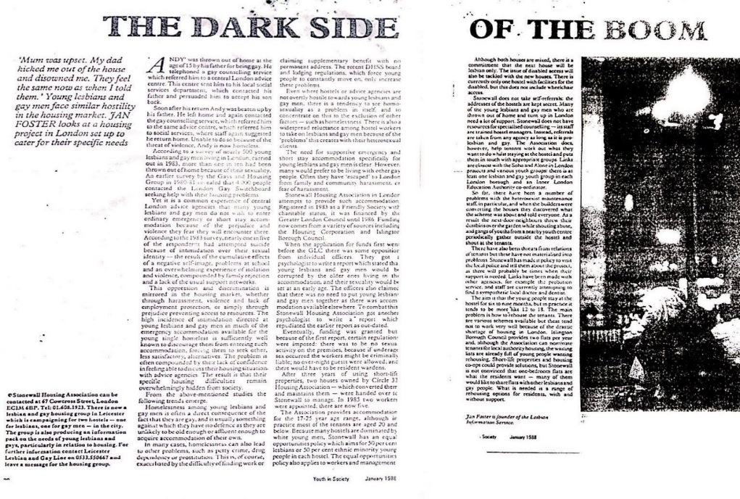
OUTLINE
Since 1983
17 staff, turnover £650,000
Supported Housing
Housing Advice
Training
New Projects
TO BE CONTINUED…
Web: stonewallhousing.org Facebook/Instagram: Stonewall Housing Twitter: @stonewallhousin
Notes:
PRIDE:
Love Happens Here, traumatic times, for some daily.
OUTLINE:
Intro, Mental health issues, Case studies, our services/resources, where to for help, how can you help?

Slide 3
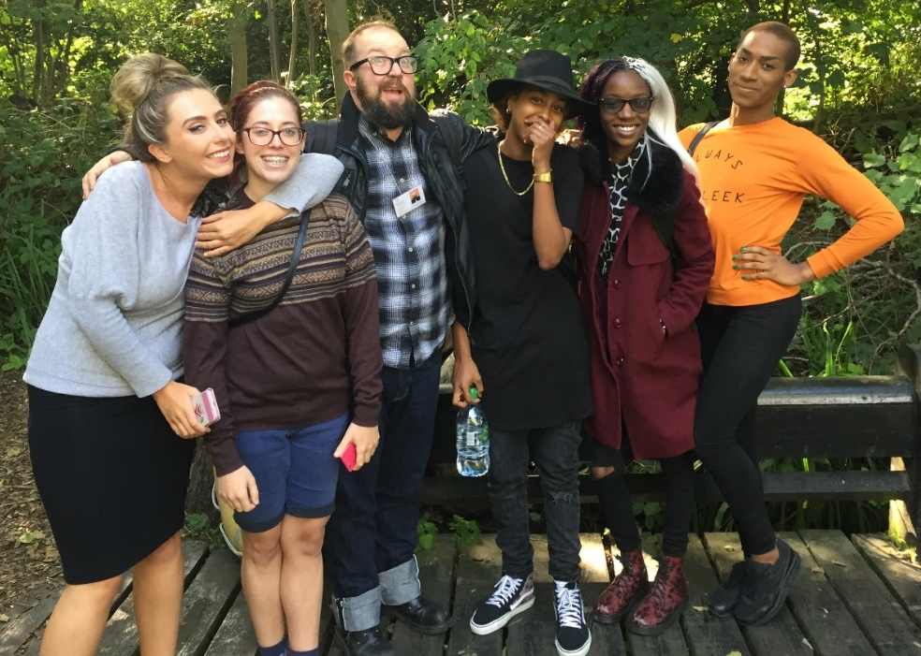
SUPPORTED HOUSING
Since 1983
Six houses for LGBT+ people aged 16 to 25
Commissioned by four London boroughs:
Hackney, Haringey, Islington and Newham
One house for LGBT+ people over 25
One house for trans people over 25
Floating support (as part of move on)
Web: stonewallhousing.org Facebook/Instagram: Stonewall Housing Twitter: @stonewallhousin
Notes:
PRIDE:
Love Happens Here, traumatic times, for some daily.
OUTLINE:
Intro, Mental health issues, Case studies, our services/resources, where to for help, how can you help?

Slide 4
ADVICE
Young: LGBT Jigsaw (AKT, Galop) & part of
London Youth Gateway (New Horizon Youth
Centre, DePaul UK)
Over 25s: STAR (Shelter, ThamesReach, St Mungo's)
Domestic Abuse: Galop, London Friend, Switchboard
Work-ready: groups and individual support
Funding from London Councils
Hardship Grants: THT, London Catalyst
68% CALLERS BLACK, ASIAN, MINORITY ETHNIC GROUP
18% TRANS
53% DISABILITY
MAJORITY SAY HOUSING ISSUE RELATES TO SEXUAL ORIENTATION OR GENDER IDENTITY
Web: stonewallhousing.org Facebook/Instagram: Stonewall Housing Twitter: @stonewallhousin
Notes:
PRIDE:
Love Happens Here, traumatic times, for some daily.
OUTLINE:
Intro, Mental health issues, Case studies, our services/resources, where to for help, how can you help?

Slide 5

TRAINING
Comprehensive training package:
Awareness raising
Domestic Abuse
Mental health
Older people
Young people
LGBT+ homelessness
Web: stonewallhousing.org Facebook/Instagram: Stonewall Housing Twitter: @stonewallhousin
Notes:
PRIDE:
Love Happens Here, traumatic times, for some daily.
OUTLINE:
Intro, Mental health issues, Case studies, our services/resources, where to for help, how can you help?

Slide 6

NEW PROJECTS
LGBT+ Rough Sleepers: working with the Outside Project to deliver an emergency shelter & community space in old Clerkenwell Fire Station, funded by Greater London Authority
LGBT+ homelessness: national training programme for the Ministry for Housing, Communities and Local Government
Domestic Abuse: Home Office funded programme of national telephone and online advice for individuals and other agencies
Manchester Extra Care Scheme: working with the Council and LGBT Foundation to develop the first LGBT+ affirmative extra care scheme
Web: stonewallhousing.org Facebook/Instagram: Stonewall Housing Twitter: @stonewallhousin
Notes:
PRIDE:
Love Happens Here, traumatic times, for some daily.
OUTLINE:
Intro, Mental health issues, Case studies, our services/resources, where to for help, how can you help?

Slide 7
TO BE CONTINUED…
Let’s Get Boroughs Together (Trust for London)
LGBT+ Housing Mayoral Campaign Group
Houseproud Pledges and Inclusion Standard
National LGB&T Partnership
LGBT+ HOME network of London LGBT+ charities
Fundraising and Initiatives
House of Stonewall - ambassadors
Any questions?
Web: stonewallhousing.org Facebook/Instagram: Stonewall Housing Twitter: @stonewallhousin
Notes:
PRIDE:
Love Happens Here, traumatic times, for some daily.
OUTLINE:
Intro, Mental health issues, Case studies, our services/resources, where to for help, how can you help?

Slide 8

Notes:
AIM:
Raise awareness about issues pertinent to both LGBT and Well being ( i.e. recognise the careful use of words on affected individuals, such as using the word ‘Depression’ adversely etc)
FORMAT:
40 minutes. Credit Suisse has over 4000 employees based in London and the event would attract 100 people or more
WELCOME:
Bob: CEO, Jenny: Mental Health Advocate, Melissa: Psychology Student
HOUSEKEEPING:
Fire alarm, toilets, mobile phones
PRIEST:
If not strike oil in 5 minutes then stop drilling, short sermons, could you not make it 4 minutes?

